Slide 1

ALGEBRA EQ: $How do we solve equations using two steps?$
Miss D’souza

Slide 2
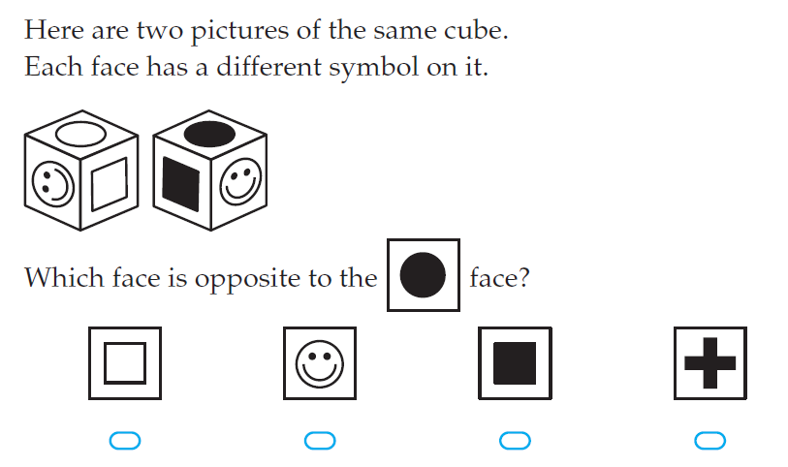

5 questions:
Find the median (45, 20, 41, 38, 42, 42)
Give an example of collecting continuous numerical data
$6xy ×3xz=$
Expand the brackets; $3(x+4)$
.

Slide 3

$$TOPIC: Algebra$$
$$EQ:How do we solve equations using one step?$$
What is an equation?
A mathematical statement that two things are equal
How do we find equivalent equations?
OPTION 1: Backtracking
OPTION 2: Balancing both sides

Slide 4












$$TOPIC: Algebra$$
+
$$−$$
$$EQ:How do we solve equations using one step?$$
How do we find equivalent equations?
OPTION 1: Backtracking
$$2x+5=13$$
×
÷
$$×2$$
$$+ 5$$
$$x$$
$$2x$$
$$2x+5$$
$$4$$
$$8$$
$$13$$
$$÷2$$
$$− 5$$

Slide 5








$$TOPIC: Algebra$$
$$EQ:How do we solve equations using one step?$$
How do we find equivalent equations?
OPTION 2: Balancing both sides
$$3x −6 =9$$
$$+ 6$$
$$+ 6$$
$$3x =15$$
$$÷3$$
$$÷3$$
+
$$−$$
$$x =5$$
×
÷

Slide 6











I DO (LHS)
$$4x+10=30$$
+
$$−$$
×
÷
$$×4$$
$$+ 10$$
$$x$$
$$4x$$
$$4x+10$$
$$5$$
$$20$$
$$30$$
$$÷4$$
$$− 10$$

Slide 7







I DO (LHS)
$$4x+10=30$$
+
$$−$$
×
÷
$$4x+10 =30$$
$$−10$$
$$−10$$
$$4x =20$$
$$÷4$$
$$÷4$$
$$x =5$$

Slide 8


WE DO (LHS)
+
$$−$$
$$\frac{x}{2}+8=13$$
×
÷
$$x$$

Slide 9



WE DO (LHS)
+
$$−$$
$$\frac{x}{2}+8=13$$
×
÷
$$\frac{x}{2}+8 =13$$
$=$
$=$

Slide 10
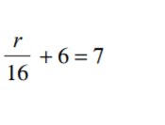
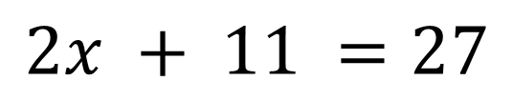
Answer the questions (only choose ONE option)
$$2x + 11 =27$$

Slide 11
1) Complete the worksheet
2) Complete your SUMMARY

